Slide 1
0615

Slide 2
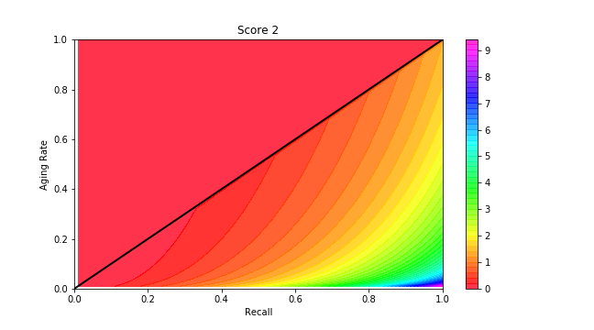
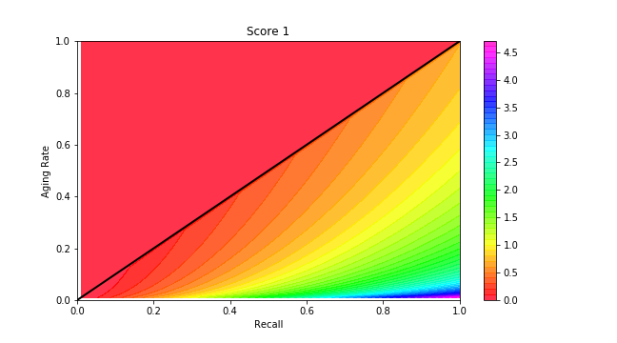
Score
Score = (r/(1.5-r)) * log(1 + eff) when eff > 1

Slide 3
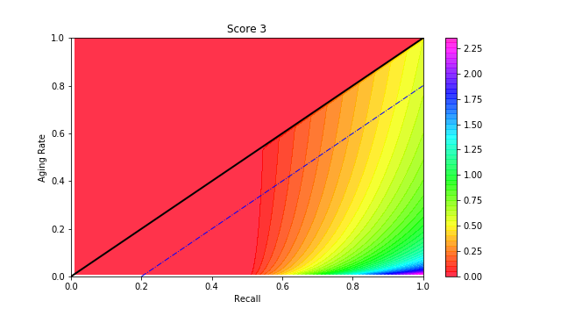
Score
Score = (r-0.5) * log(2 + eff) when eff > 1

Slide 4
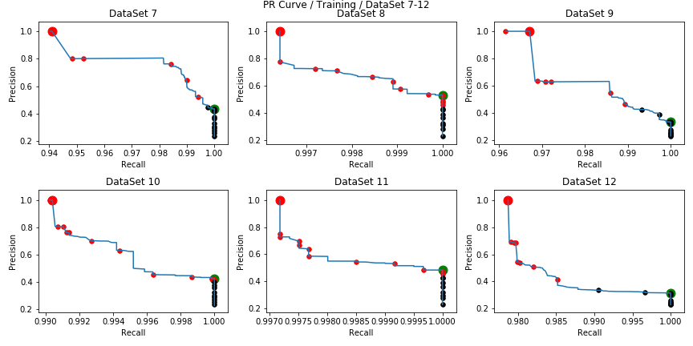
AdaRegressor (Cont / BR=0.3)

Slide 5
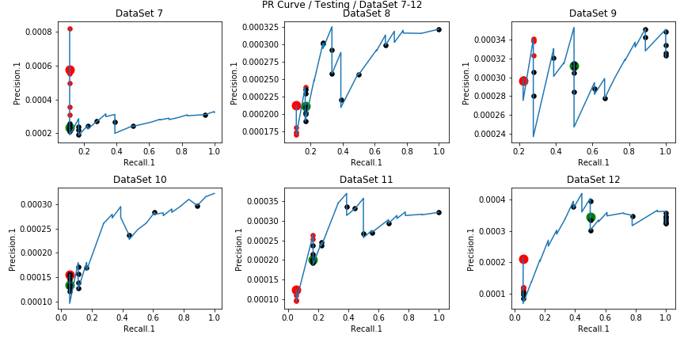
AdaRegressor (Cont / BR=0.3)

Slide 6
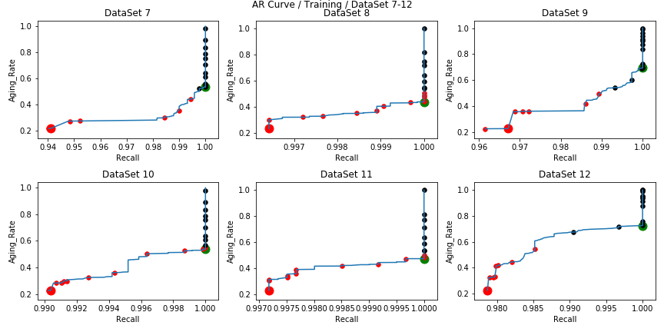
AdaRegressor (Cont / BR=0.3)

Slide 7
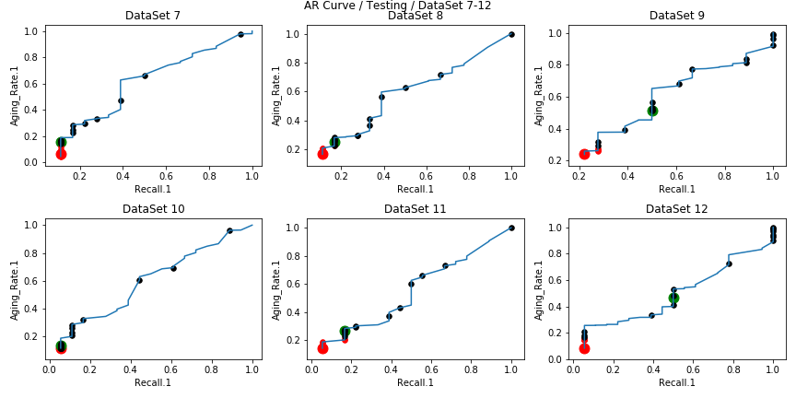
AdaRegressor (Cont / BR=0.3)

Slide 8
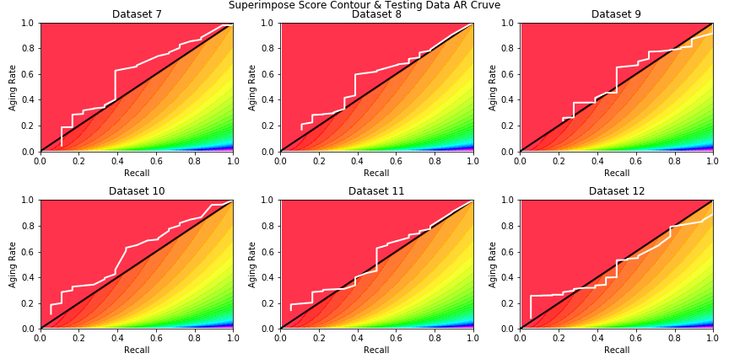
Superimpose with Score Contour

Slide 9
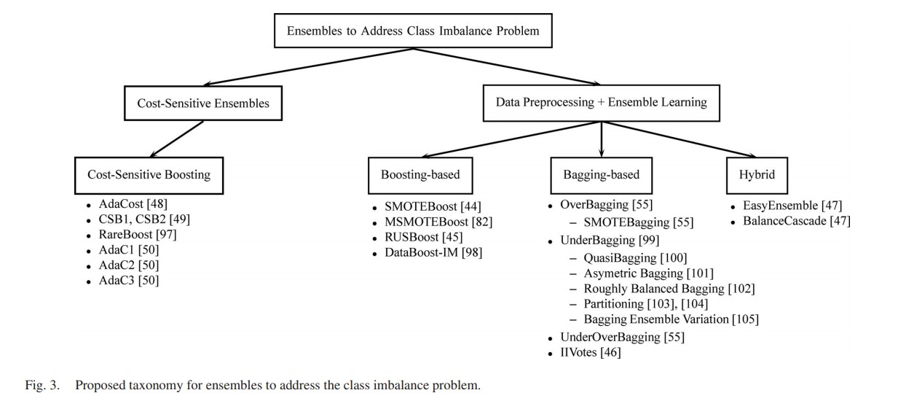
Ensemble Methods for Imbalance Data
(Galar et al., 2012)

Slide 10
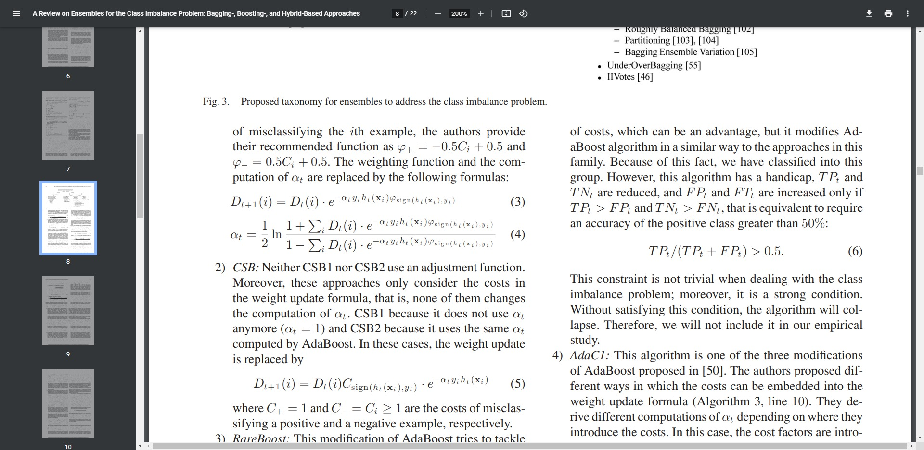
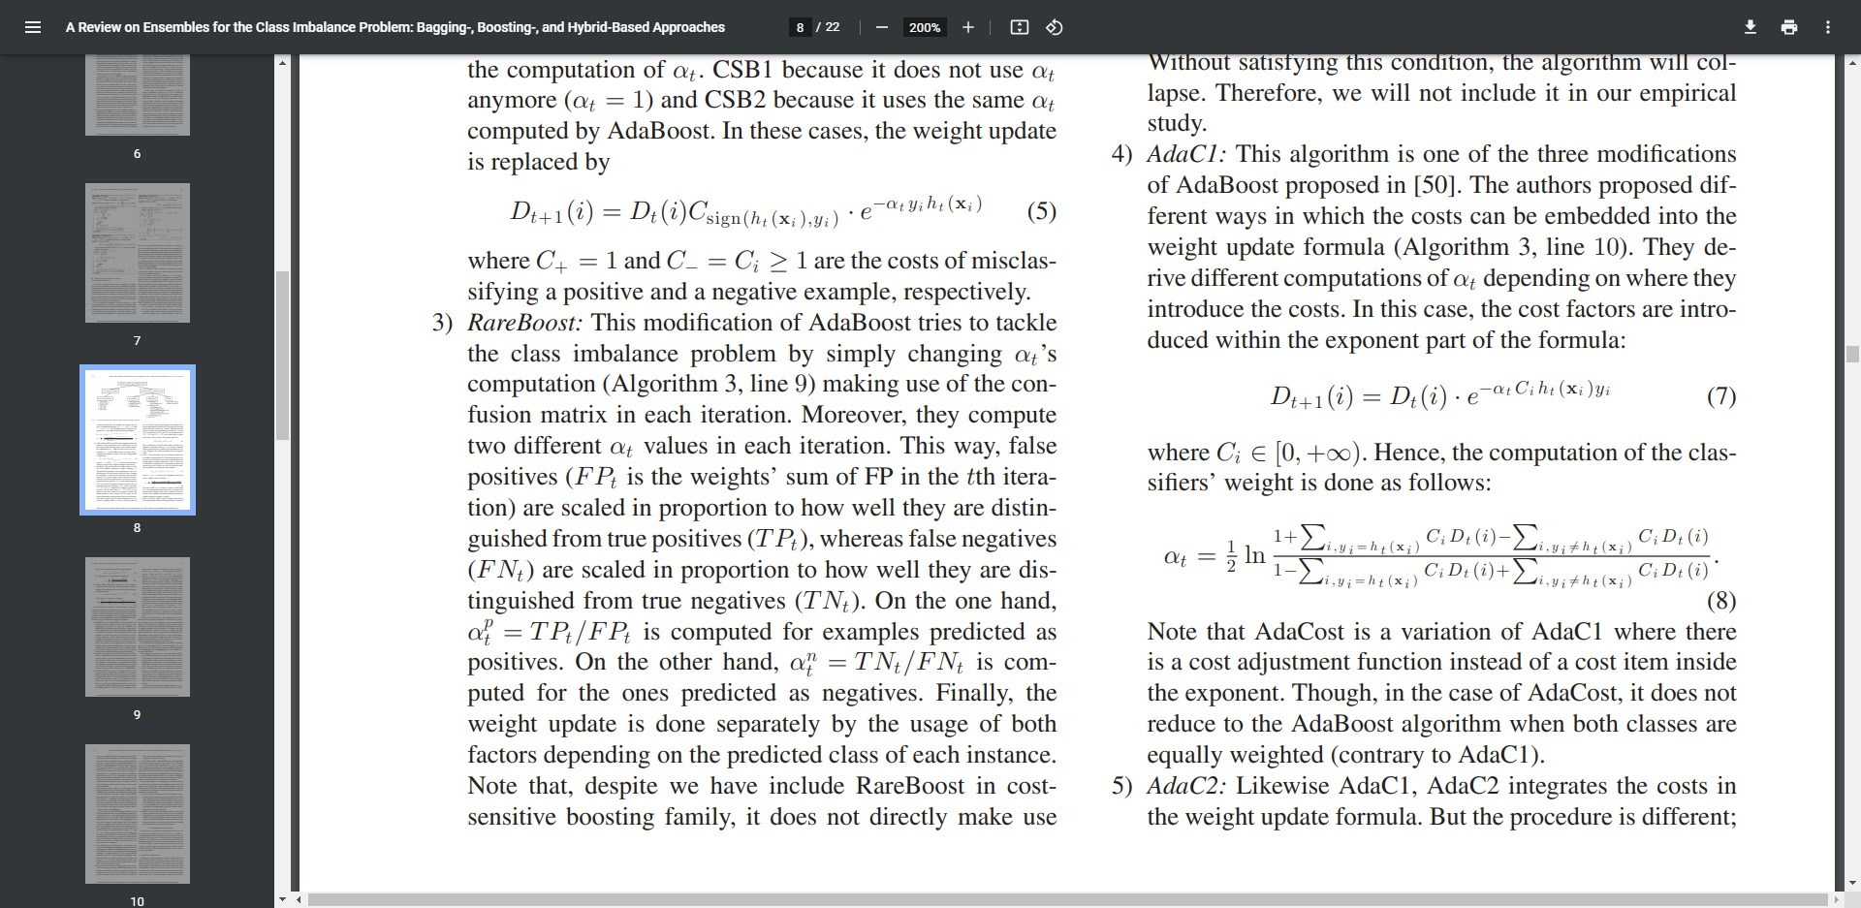
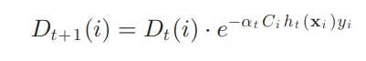
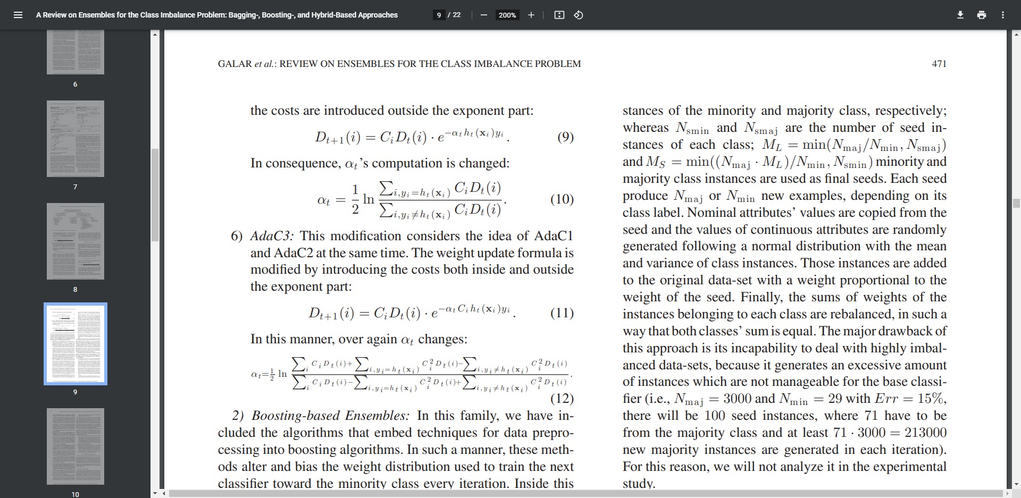
Cost-Sensitive Boosting
AdaCost :
CSB1, 2 :
RareBoost :
AdaC1, 2, 3 :

Slide 11
Data Preprocessing + Boosting
SMOTEBoost
MSMOTEBoost ➔ based on MSOMTE (safe, border & latent noise)
RUSBoost
DataBoost-IM ➔ nominal attributes are copied from the seed; continuous attributes are from normal distribution
M_{L} = min(N_{maj}/N_{min}, N_{smaj}) M_{S} = min((N_{maj} · M_{L} )/N_{min}, N_{smin} )
➔ each produce N_{maj} ➔ each produce N_{min}

Slide 12
Data Preprocessing + Bagging
OverBagging
SMOTEBagging ➔ resampling rate (a%) is set in each iteration
UnderBagging
AsymmetricBagging
QuasiBagging
Roughly-balanced Bagging
Partitioning
UnderOverBagging
Imbalanced Ivotes ➔ integrates the SPIDER data preprocessing technique with Ivotes SPIDER (selective preprocessing of imbalanced data) ➔ (weak / relabel / strong) mode

Slide 13
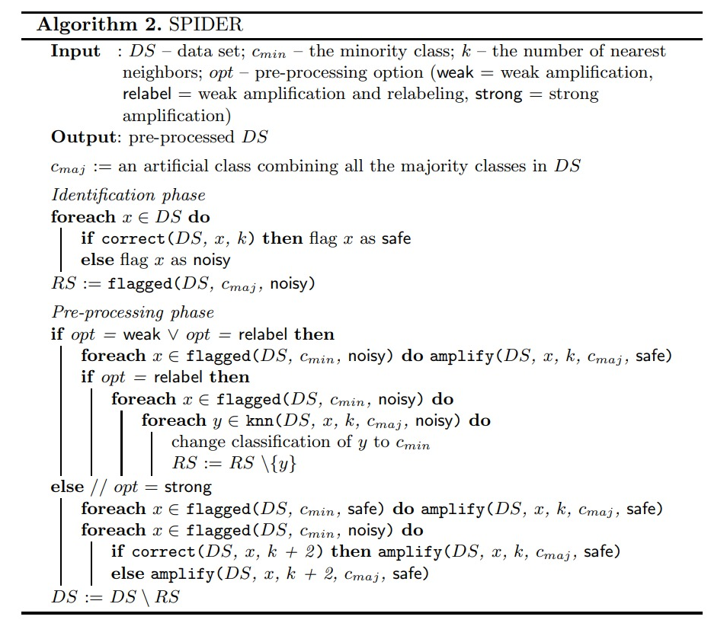
(Kryszkiewicz et al., 2010)

Slide 14
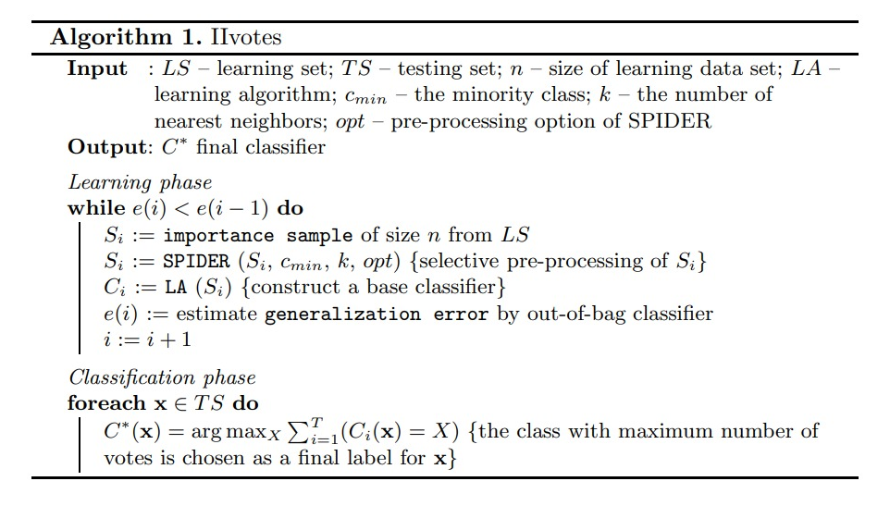
(Kryszkiewicz et al., 2010)

Slide 15
Hybrid Ensembles
EasyEnsemble
Each bag is constructed by RUS from the majority class & all the instance from minority class
BalanceCascade
Correctly classified majority examples with high confidence are removed from the dataset

Slide 16
Under-Sampling
Cluster-based
By k-means clustering (Lin et al., 2017)
Distance-based
Parallel selective sampling (PSS) (D’Addabbo & Maglietta, 2015)
Evolutionary-based
Evolutionary-based ensemble under-sampling (EEU) (Zhang et al., 2019)
Learning from class-imbalanced data: Review of methods and applications (2016)

Slide 17
Hybrid-Sampling
Random/Distance-based over-sampling + under-sampling
Distance-based over-sampling + Cluster-based under-sampling
Novel
Different contribution sampling (DCS) (Jian et al., 2016)
Learning from class-imbalanced data: Review of methods and applications (2016)

Slide 18
Automatic-Tuning
Particle swarm optimization
https://github.com/kuhess/pso-ann
Bayesian optimization
https://towardsdatascience.com/automated-machine-learning-hyperparameter-tuning-in-python-dfda59b72f8a

Slide 19
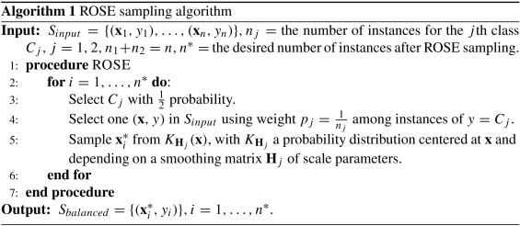
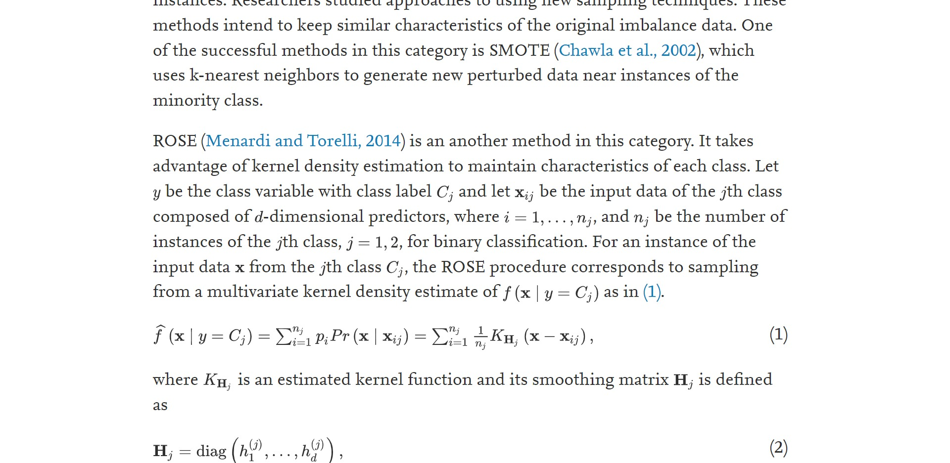
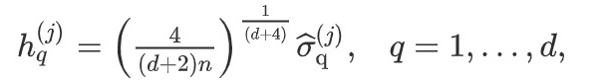
ROSE
(Menardi & Torelli, 2014)

Slide 20
RHSBoost
(Gong & Kim, 2017)

